Slide 1
Module 5 – Social Context
Training Modules for Applying the Mitigation Hierarchy:
Planning Policy and Projects for No Net Loss or a Net Gain of Biodiversity
Module 5
Making sure No Net Loss / Biodiversity Net Gain works for people

Slide 2
Making Net Gain Work for People – Abstract
‘Biodiversity’ involves not only intrinsic but also socioeconomic values, so Biodiversity Net Gain must work for people as well as biodiversity.
This module explores the social component of mitigation. It sets out why stakeholder buy-in to mitigation measures is crucial, and how projects and mitigation can affect local communities.
The module describes how BNG/NNL for people is integral to the BBOP Principles, Standard, Guidance Notes and Handbooks, and also to the IFC Performance Standards.
It introduces the Good Practice Principles for ensuing No Net Loss for biodiversity as well as biodiversity. It describes the roles communities can play in helping define, implement and monitor mitigation policy and mitigation measures for specific projects.

Slide 3
Making Net Gain Work for People – Contents
Contents | Slides
Why address the social impacts of projects and their mitigation measures? | 4-7
What does No Net Loss or Biodiversity Net Gain for people mean? | 8
What do standards like BBOP and IFC say about social issues of biodiversity mitigation? | 9-12
What are the role for communities in BNG/NNL policy and practice? | 13-14
Take home messages | 15

Slide 4
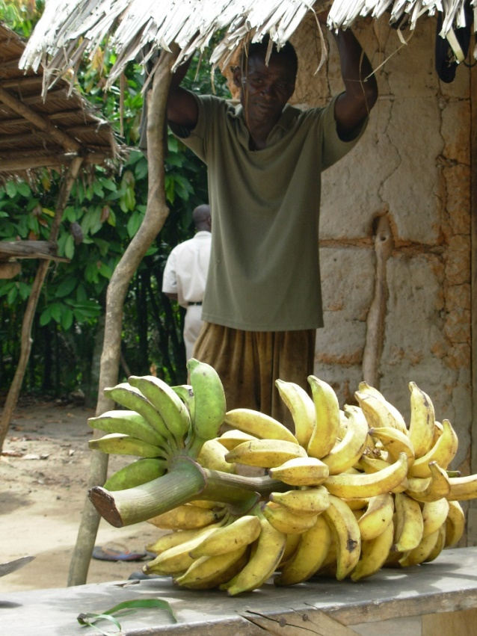
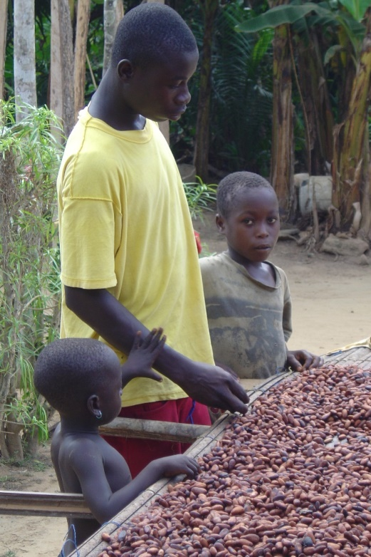
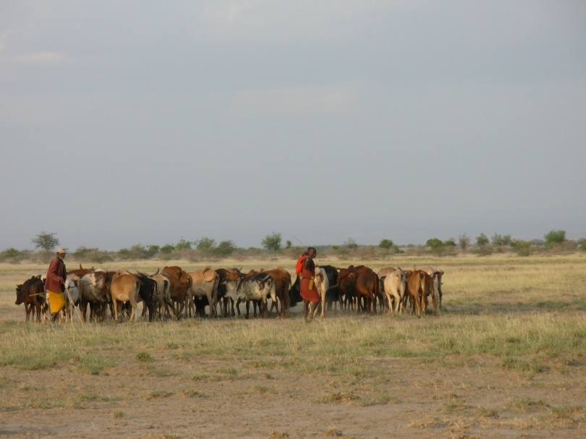
Stakeholder buy-in is crucial
Local communities see the benefit of projects and their mitigation measures and support them
Government supports the conservation outcomes
This section covers the social component of NNL/BNG
Notes:
Developers and policy-makers need to work closely with the people affected by the project and those who can help ensure the success of the project and mitigation measures, including biodiversity offsets.
Among the most important stakeholders and local communities and indigenous peoples who may be affected EITHER by the project itself, OR by the mitigation measures (including offsets).
Another key stakeholder is government, particularly regional or local government with authority for planning and project consent.
It’s also helpful for developers to collaborate with other stakeholders such as conservation groups who can identify local conservation priorities and apply the methods we’ll discuss today for best practice in the design and implementation of mitigation including biodiversity offsets.

Slide 5
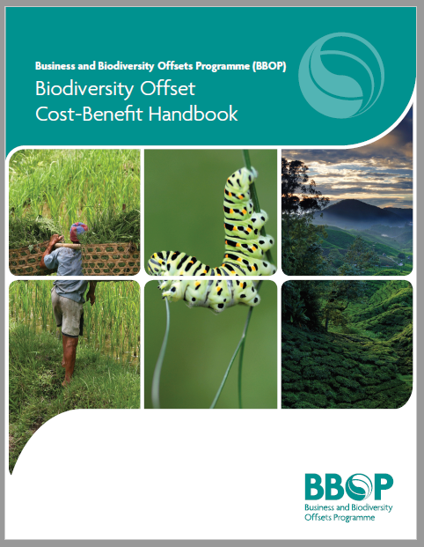
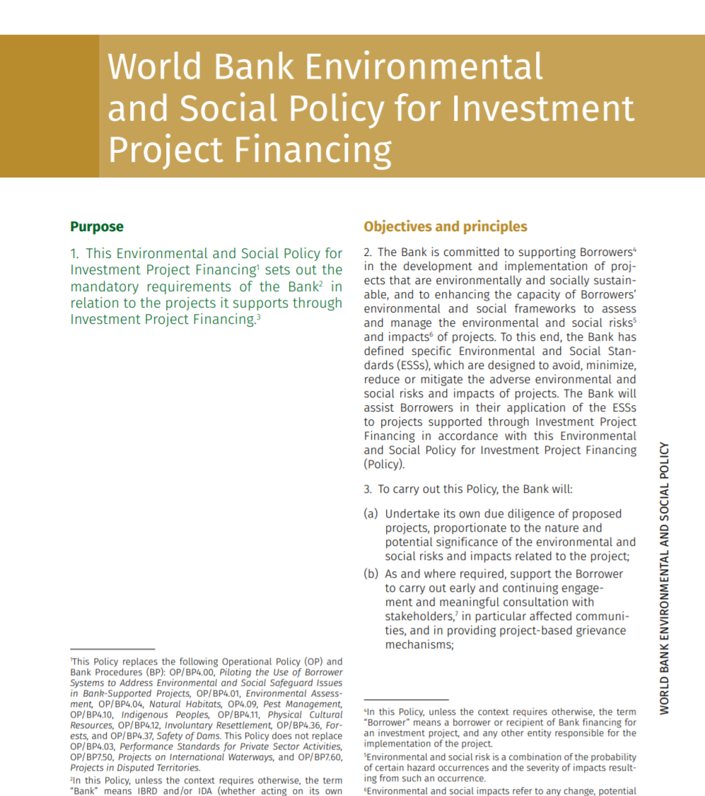
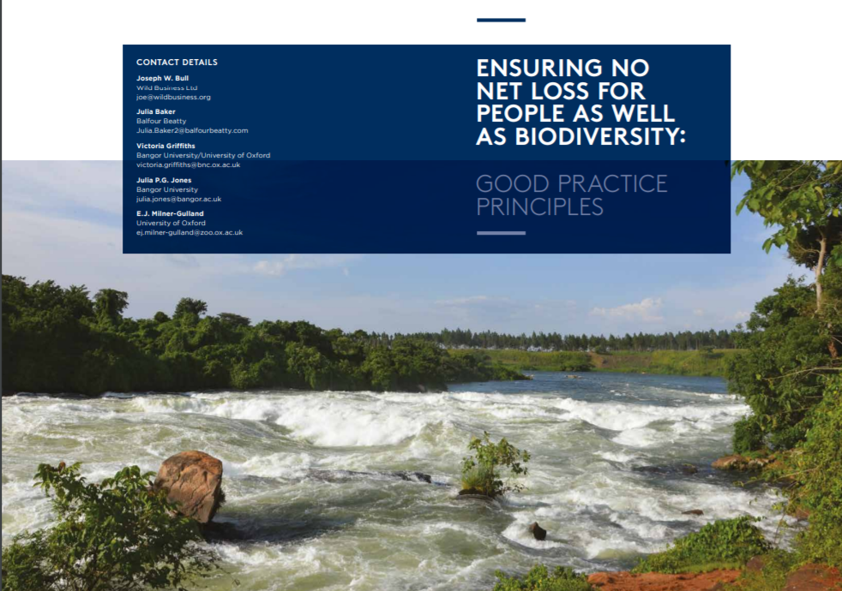
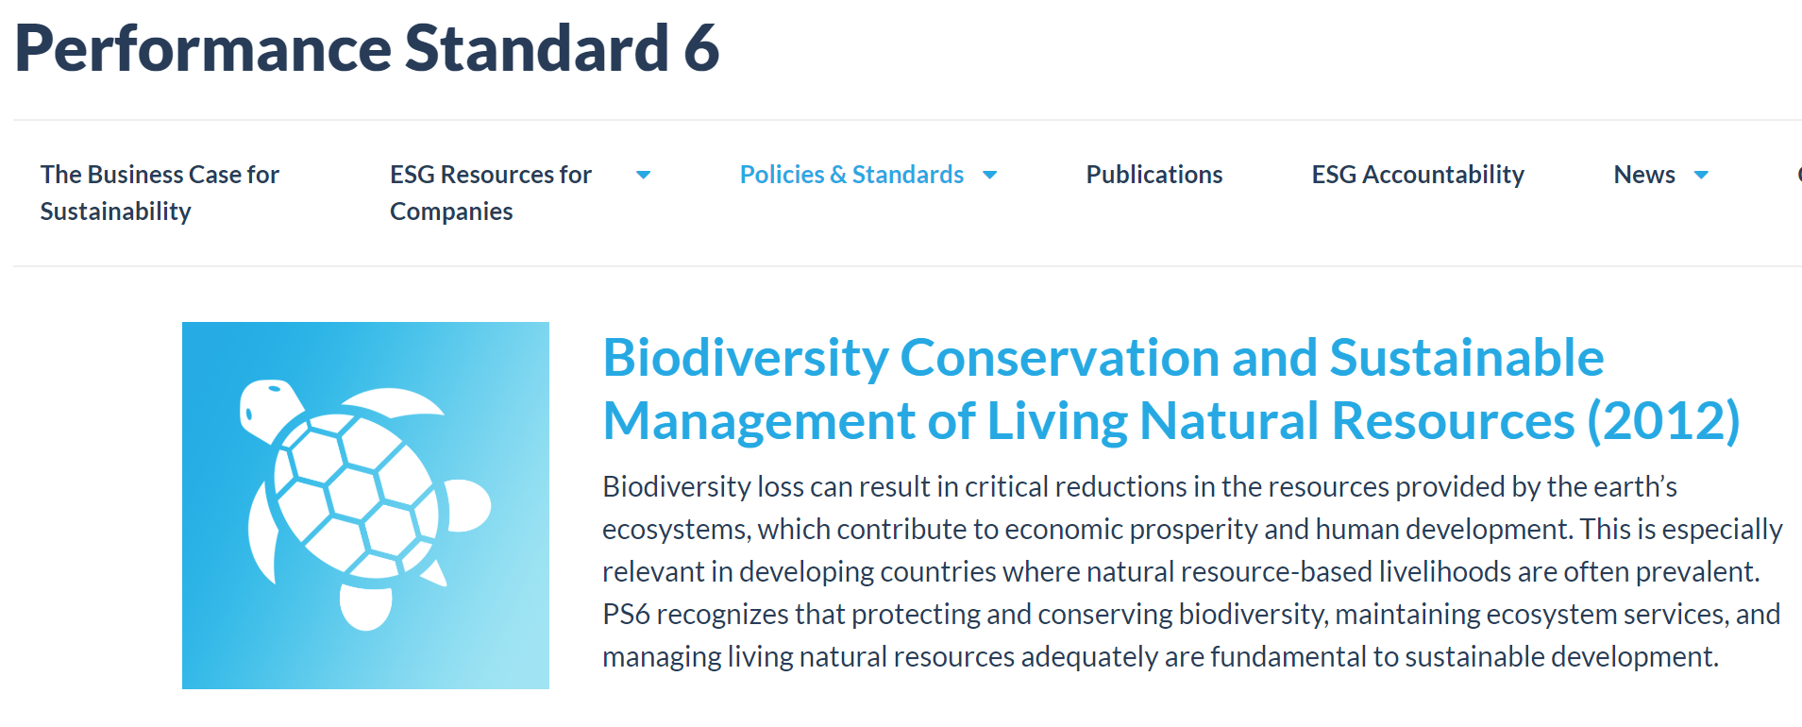
Why address the social impacts of NNL/BNG?
Why do the social impacts of NNL/NG need to be considered?
Right thing to do:
The moral imperative, reflected in best practice guidelines e.g. BBOP (2009) states efforts to achieve conservation gains should make local people “no worse off”
Practical imperative:
License to operate for developers. And effectiveness of mitigation (including offsets) depends on it.
Requirements and standards:
National policies and regulations may require this and so do IFC, World Bank and other performance standards.

Slide 6
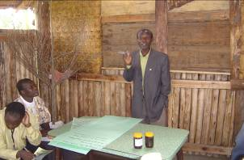
The social component of NNL/BNG
Mitigation measures designed to conserve biodiversity can have a negative social and environmental impact on people’s livelihoods and access to nature:
Projects’ impacts can cause loss and degradation of biodiversity that people value. Biodiversity provided by an offset that’s considered ‘equivalent’ and is likely in another place may not address people’s place-based values and may not be accessible.
Mitigation delivered by conservation can restrict use of natural resources (eg no hunting/gathering or access to a newly designated protected area, or stopping agricultural expansion) affecting livelihoods, especially of the poor.
Source: BBOP, Bull et al.

Slide 7
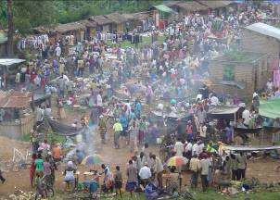
The social component of NNL/BNG
Social challenges are common to all conservation projects (not unique to offsets/compensation), but are particularly significant for projects affecting indigenous peoples and local communities who are highly dependent on natural resources.
There are many lessons from experience with conservation projects to help us ensure people are not adversely affected, either by development projects themselves or measures to mitigate their impact on biodiversity.

Slide 8
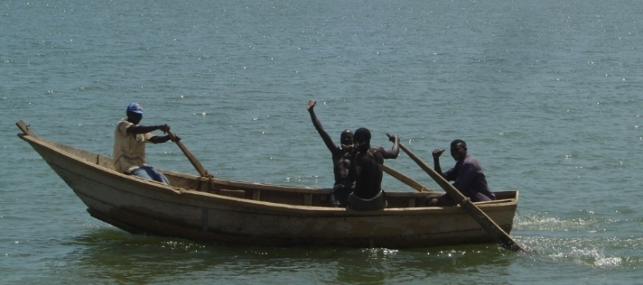
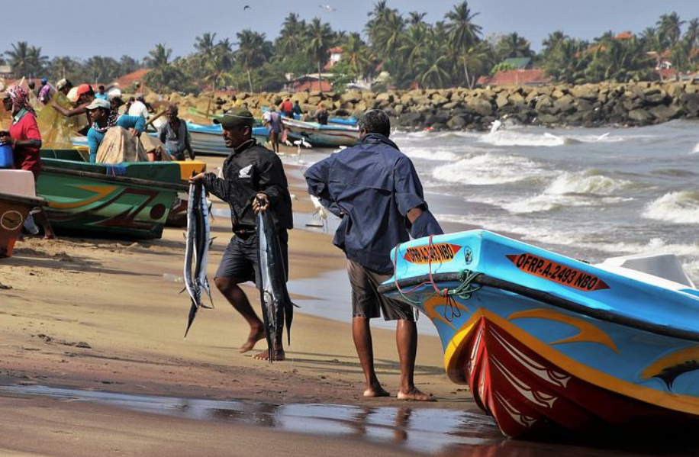
NNL/BNG for people as well as biodiversity
No Net Loss and Biodiversity Net Gain include no net loss of socioeconomic and cultural values of biodiversity (as well as intrinsic values like listed species)
National systems and individual projects should be designed so they leave affected communities at least as well off – and preferably better – than they were before.

Slide 9
NNL/BNG for people as well as biodiversity:
BBOP
BBOP Principles, Standard, Guidance Notes and Handbooks set out how to ensure people affected by a project and its mitigation are left at least as well off as before:
Principle 4 - No net loss: A biodiversity offset should be designed and implemented to achieve in situ, measurable conservation outcomes that can reasonably be expected to result in no net loss and preferably a net gain of biodiversity.
Includes loss and gain of people’s socioeconomic and cultural values associated with biodiversity.
Principle 6 - Stakeholder participation and Principle 7 - Equity:
Participation and considerations of equity in decision-making about projects and mitigation (including biodiversity offsets) should help ensure people affected are left better not worse off.
Biodiversity Offset Management Plan (BOMP) should include a description of the project’s impacts on biodiversity (including direct, indirect, and cumulative impacts, as appropriate) including on the key biodiversity components identified and then how these are addressed through mitigation and involvement of affected people.
BOMP should help ensure people affected are left better not worse off.
Notes:
Principle 4- No net loss: A biodiversity offset should be designed and implemented to achieve in situ, measurable conservation outcomes that can reasonably be expected to result in no net loss and preferably a net gain of biodiversity.
Principle 6- Stakeholder participation: In areas affected by the development project and by the biodiversity offset, the effective participation of stakeholders should be ensured in decision-making about biodiversity offsets, including their evaluation, selection, design, implementation, and monitoring.
Principle7- Equity: A biodiversity offset should be designed and implemented in an equitable manner, which means the sharing among stakeholders of the rights and responsibilities, risks and rewards associated with a development project and offset in a fair and balanced way, respecting legal and customary arrangements. Special consideration should be given to respecting both internationally and nationally recognised rights of indigenous peoples and local communities.
Biodiversity Offset Management Plan (BOMP) should include a description of the project’s impacts on biodiversity (including direct, indirect, and cumulative impacts, as appropriate) including on the key biodiversity components identified. Include consideration of the intrinsic, socioeconomic and cultural values of biodiversity.

Slide 10
NNL/BNG for people as well as biodiversity:
BBOP Cost Benefit Handbook
The steps in the Cost-Benefit Handbook are designed to help offset planners do their best to ensure that:
Local people are no worse off through the presence of the project in terms of its impact on biodiversity related livelihoods;
Local people at the offset site are no worse off as result of the biodiversity offsets, as appropriate and equivalent benefits are built into the offset to compensate for any negative impacts they cause; and
Calculations of the conservation gain of the biodiversity offset activities are realistic in the assumptions made about how local people will become involved in the offsetting activities.
This requires a cost-benefit comparison between:
the benefits of the offset, and
the costs to local people of the residual biodiversity related impacts of the project and of the offsets
The Handbook provides guidance on how to use economic tools of valuation and cost-benefit analysis to address these challenges.
Notes:
To be successful, biodiversity offsets should compensate indigenous peoples, local communities and other local stakeholders for any residual impacts of the project on their biodiversity based livelihoods and amenity. They also need to deliver the required conservation gains without making local people worse off, for example due to land and resource use restrictions created by the biodiversity offset.

Slide 11
NNL/BNG for people as well as biodiversity: IFC
IFC Performance Standard 6: Biodiversity Conservation and Sustainable Management of Living Natural Resources, recognizes maintaining ecosystem services
is fundamental to sustainable development.
PS 1: Assessment and Management of Environmental and Social Risks and Impact – coherent approach to all PSs and stakeholder engagement.
PS 5: Land Acquisition and Involuntary Resettlement recognises project-related land acquisition causing physical or economic displacement and restrictions on land use can have adverse impacts on local people.
PS 7: Indigenous Peoples requires specific consideration of any indigenous peoples impacted by a project. Explicit requirement for Free Prior Informed Consent (FPIC), influences how projects deal with social impacts.

Slide 12
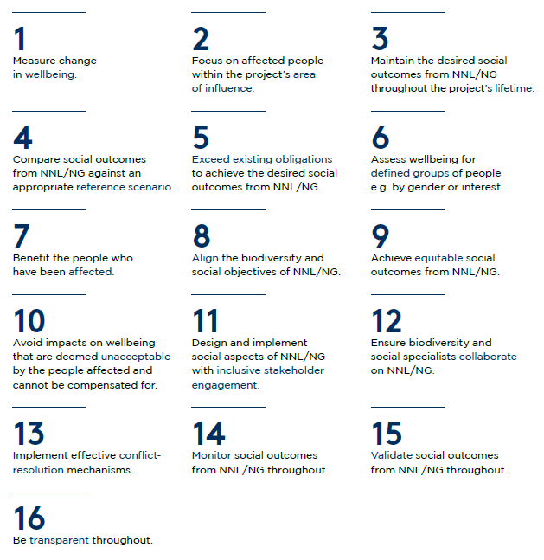
NNL/BNG for people as well as biodiversity:
Good practice principles
Sixteen good practice principles for addressing the social impacts that arise from all losses and gains in biodiversity from a development project and its NNL/BNG activities.
Founded on international best practice calling for development projects to achieve biodiversity NNL/BNG while ensuring that affected people are ‘no worse off and preferably better off’.
Defines measurable social outcomes from biodiversity NNL/BNG.
Provides a framework for assessing whether the social aspects of biodiversity NNL/BNG have been designed and implemented in accordance with good practice.
Facilitates closer working between stakeholders involved with biodiversity NNL/BNG projects, especially between ecological and social specialists, throughout a project.

Slide 13
NNL/BNG for people and biodiversity:
Roles for communities
Local communities and indigenous peoples can have several different roles in ensuring this No Net Loss/Biodiversity Net Gain and that they are not adversely affected by projects and their mitigation. They should:
Be consulted in the design of the NATIONAL SYSTEM for mitigating impacts on biodiversity (including offsets)
Have the opportunity to play a part in mitigation of impacts for SPECIFIC PROJECTS, including:
Participation in assessment of the project’s likely impacts on biodiversity (particularly impacts on people’s cultural and livelihood values) and proposed mitigation measures
Paid to implement the offset (create the conservation gains)
Involved in governance/oversight of the offset
Involved in monitoring and evaluation

Slide 14
Making Biodiversity Net Gain
work for people
⇒ Also see the module on Roles of Communities XXXX

Slide 15
Making Net Gain Work for People – take home messages
For mitigation measures to succeed, Biodiversity Net Gain must work for people as well as for biodiversity.
This is the fair and right thing to do, is practically necessary to secure license to operate for developers and effectiveness of mitigation and satisfies national policies and performance standards.
National systems and individual projects should therefore be designed so they leave affected communities at least as well off – and preferably better – than they were before.
The BBOP Principles, Standard, Guidance Notes and Handbooks set out how to ensure people affected by a project and its mitigation are left at least as well off as before.
The IFC’s Peformance Standards also set out requirements for stakeholder engagement, including free prior and informed consent for indigenous peoples.
The sixteen good practice principles address the social impacts that arise from all losses and gains in biodiversity from a development project and its NNL/NG activities.
Local communities and indigenous peoples can help ensure the effectiveness and fairness of NNL/BNG by being involved in the design of national systems for mitigating impacts on biodiversity (including offsets) and by participating in assessment of projects’ impacts, implementing offsets, taking a role in governance/oversight of mitigation measures, and in monitoring and evaluation.

